Slide 1
BookAdda
A Book Recommendation System

Slide 2
Team BookAdda
Foram Jivani (201711012)
Smriti Changulani (201711019)
Dhruva Shah (201711024)
Mausamee Patel (201711056)
IT-562
Prof. Sourish Dasgupta

Slide 3
Decision Parameters
Model
Training and Testing Dataset
Training Algorithm
Results
Outline

Slide 4
Decision Parameters
User Ratings
User Likes
Book Author
Book Genre

Slide 5
Model
Item Item Based Similarity
Combine
Genre - Author Based Similarity
Input
Output
Popularity Based

Slide 6
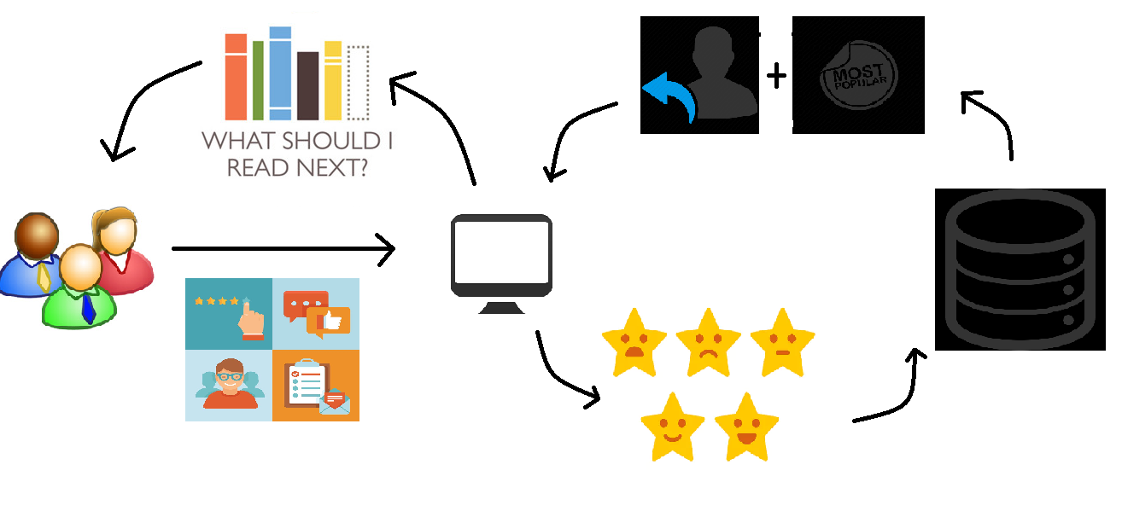
DATASET
Hybrid model
What Should I Do NExt?
DATASET

Slide 7
Training and Testing Data
We have used following dataset files:
Ratings_test_900.csv
books_test_SVD1_900.csv
Which consists of
#of Users : 7000
#of books : 1000
#of Ratings : 11400

Slide 8
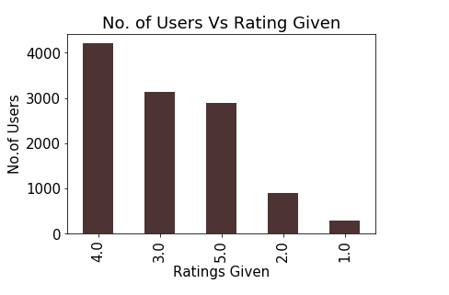

Slide 9
Training Algorithm
For current login user, apply SVD to show the top 10 items and top 5 popular items.
When user take any action, apply
Item-Item Based Similarity
Genre-Author Based Similarity
Popularity Based model.
Based on past and current ratings, show
Output=New Recommendation list
If user takes any action repeat step (II) and (III) until logout.
Notes:
User action...rating/like/dislike
r-0/5 like/dislike-5/0
Based on rating,,,ll get current rated items..apply IISIM, ZASIM,,popu
For IISIM- 6 books -Cosine sim -
ZASIM-4 books - Cosine sim,
New reco 10 items list,
Again user input….same procedure
Svd only when login…
Based on current reco and past nd current rating op ll shown

Slide 10
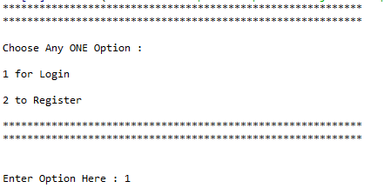
Results
On Login

Slide 11
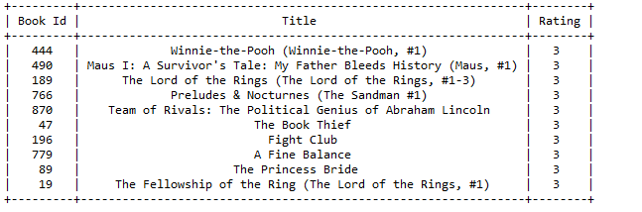
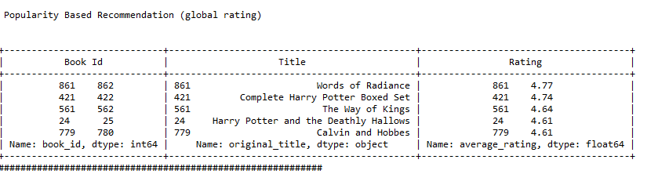
Results
Top 10 recommendation using SVD
Popularity Based Recommendation

Slide 12
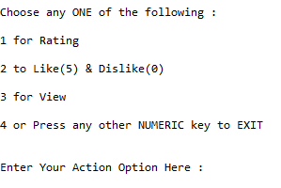
Results
Actions that can be taken

Slide 13
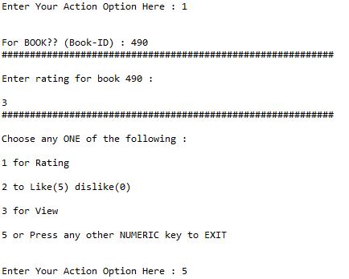
Results
User Actions

Slide 14
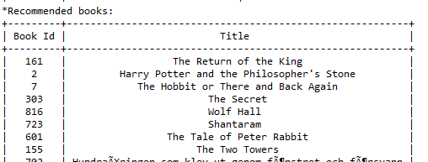
Results

Slide 15
Thank you!

Slide 16
Any Questions?

